Slide 1
Heroes of CSS

Slide 2
Admin Work

Slide 3
Homework Assignment
Also, at this point everyone should have access to the class repository in GitHub.
Homework Assignment #1 is Due:
Saturday September 29
But turn your homework in early if you’re able to work ahead!

Slide 4
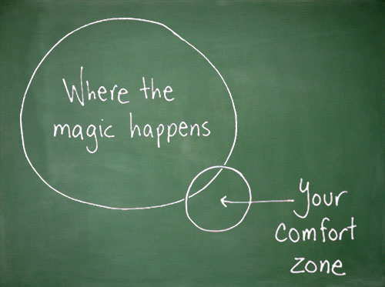
Most Important with Every Homework and Class Assignment….
Just Submit SOMETHING (even if it seems pretty crummy)!

Slide 5
Warning!

Slide 6

Brace Yourselves
Today is going to be a bit tough.
But trust us!
It will all look easy a few weeks from now.

Slide 7
Brace Yourselves
Don’t expect to understand EVERYTHING at once.
Today is all about getting immersed.

Slide 8
CSS Recap

Slide 9
Critical Question
What is “CSS?”

Slide 10


HTML / CSS Definitions (*yawn* unimportant)
HTML: Hypertext Markup Language – (Content)
CSS: Cascading Style Sheets – (Appearance)
HTML/CSS are the “languages of the web.” Together they define both the content and the aesthetics of a webpage – handling everything from the layouts, colors, fonts, and content placement. (JavaScript is the third – handling logic, animation, etc.)

Slide 11


HTML / CSS Analogy
HTML Alone
Like writing papers in “Notepad.”
Can only write unformatted text.
HTML / CSS
Like writing papers in Microsoft Word.
Can format text, page settings, alignment, etc. based on “highlighting” and menu options.

Slide 12

Basic HTML Page - Result

Slide 13

Enter CSS - Result

Slide 14
Critical Question
How do we style HTML…
Elements?
Classes?
IDs?

Slide 15

CSS Syntax
CSS works by hooking onto selectors added into HTML using classes and identifiers.
Classes use .classname, IDs use #idname, and elements use just their name.
Once hooked, we apply styles to those HTML elements using CSS.

Slide 16
Selectors
Element selector
Applies to all <p> elements
p {
background-color: blue;
}
Applies to all elements with class=“classItem"
.classItem {
background-color: orange;
}
Applies to all elements with id=“idItem"
#idItem {
background-color: green;
}
Element name
(p, a, div, span, etc)
Class Selector
Period (.) + variable name
(.myDiv, .phoneNumber, etc.)
ID Selector
Hash (#) + variable name
(#myDiv, #phoneNumber)

Slide 17
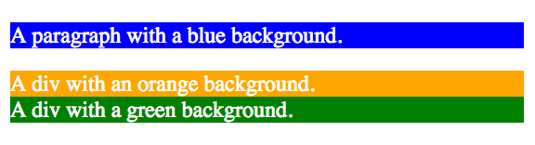
CSS Selectors
p {
background-color: blue;
}
.classItem {
background-color: orange;
}
#idItem {
background-color: green;
}
<p>
A paragraph with a blue background.
</p>
<div class=“classItem">
A div with an orange background.
</div>
<div id=“idItem">
A div with a green background.
</div>
+

Slide 18
Lingering Questions
Questions so far?

Slide 19
Relative File Paths

Slide 20
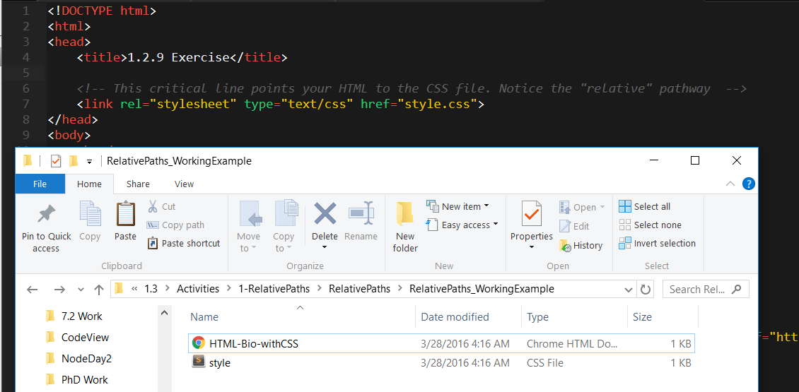
Relative File Paths
Relative file paths connect us with other files in our working directory. In this case, style.css is in the same folder as our html document.

Slide 21
I will demonstrate Relative Paths …. Then it is your turn

Slide 22
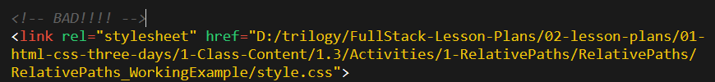

Absolutely No Absolute Paths
VERY VERY BAD
ALWAYS USE RELATIVE FILE PATHS.
If you deploy your sites without them, all of your links will fail.
The same will happen if you move your project from one folder to another.
Remember, there is no such thing as a “C:” drive on the internet.

Slide 23
> YOUR TURN!!
Assignment ACTIVITY 7 – README has instructions
1. Unzip the folder sent to you via Slack.
2. Edit the HTML files in all of the “RelativePaths” folders. You need to write relative paths that link the HTML documents with CSS stylesheets.
Tip: Check out the “RelativePaths_WorkingExample” folder.

Slide 24
Box Model

Slide 25
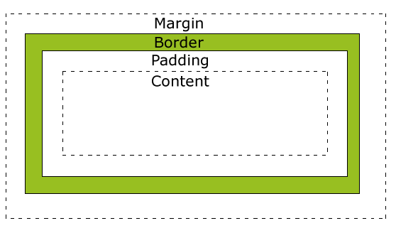
Boxes Upon Boxes
In CSS, every element rests within a series of boxes.
Each box has customizable space properties:
margin, border, and padding.
Typical spacing value: 20px 10px 10px 20px (top, right, bottom, left)

Slide 26
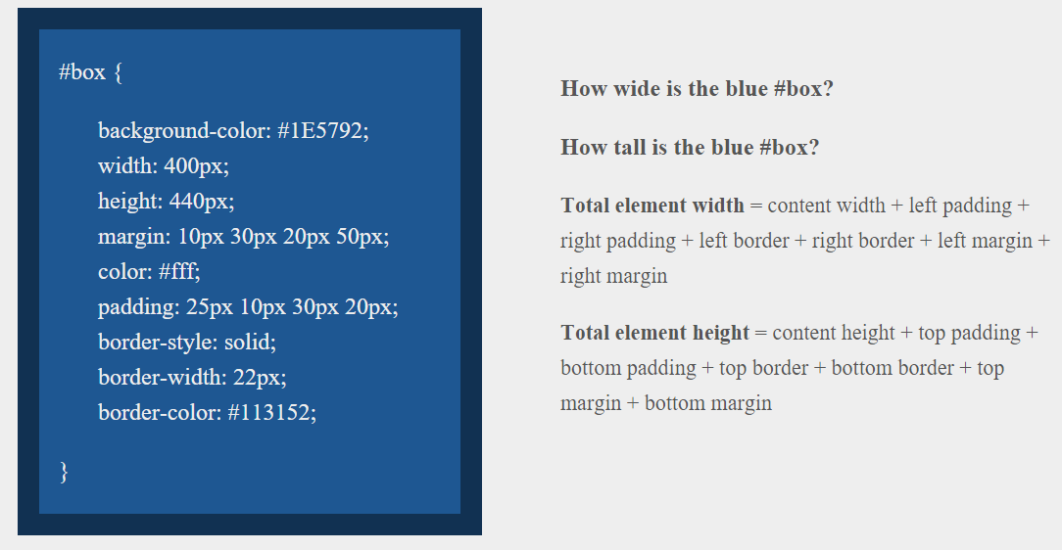
> YOUR TURN!!
Suggested Time: 10 min

Slide 27
> Solution
Answer
Width: 474 px (no margin), 554 px (with margin)
Height: 539 px (no margin), 569 px (with margin)

Slide 28
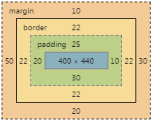
> Solution
Answer
Width: 474 px (no margin), 554 px (with margin)
Height: 539 px (no margin), 569 px (with margin)

Slide 29
We Be Floatin’

Slide 30
Take a Facebook Break…
Warning!
These next topics are fairly “tricky”… but VERY IMPORTANT.
Time to channel that inner genius.

Slide 31

The Concept of “Flow”
By default, every HTML element displayed in the browser is governed by a concept called flow.
This means that HTML elements force their adjacent elements to flow around them.

Slide 32
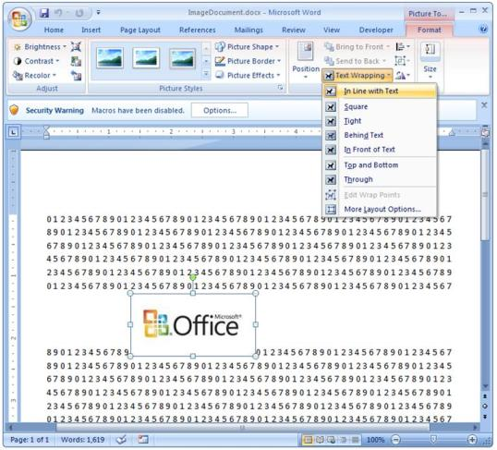
Flow Analogy to MS Word
This concept of “flow” is very similar to the wrap-text options you may be familiar with in Microsoft Word.
Just as in MS Word, you can have images in-line with text, on-top of text, etc.

Slide 33
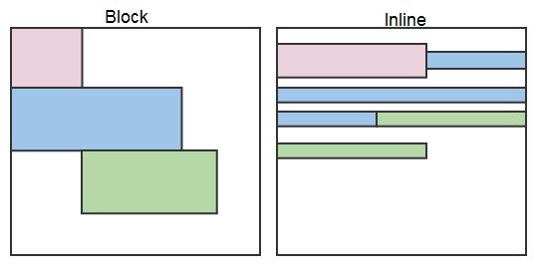
Block Elements
By default, web clients render many HTML elements as block elements. Paragraphs, headers, divs and more receive this treatment.
A block element will take up an entire line of space—unless you intervene with CSS properties.

Slide 34
Block Elements vs. Inline Elements
Now contrast the block elements with inline elements.
By using float CSS properties, we can command our website to display multiple HTML elements adjacently.

Slide 35
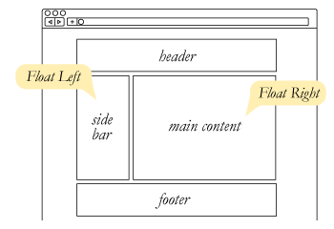
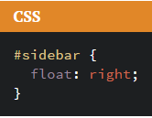
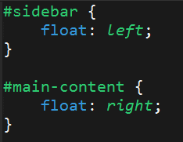
Floating
To transform these block elements into inline elements, we use a CSS property called float.
It is important to understand the concept – and you will still encounter it in legacy websites. (Many websites were constructed with floats before 2014)

Slide 36
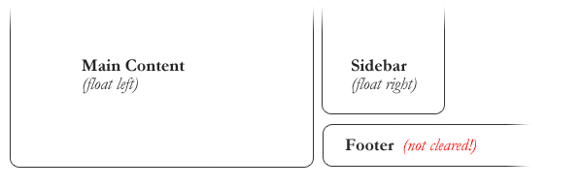
Clearing the Float
Floats often get in the way of our layouts.
Sometimes we don’t want to give each element the “inline” treatment.

Slide 37
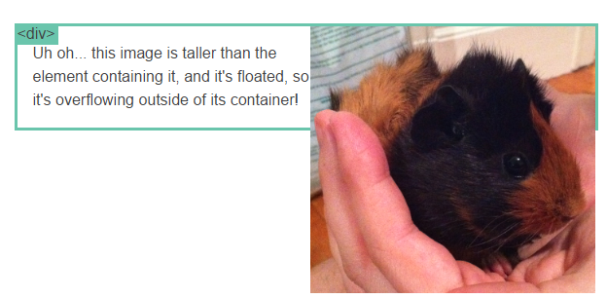
Clearfix Hack
Sometimes when elements don’t match up in size, we get situations like the above…

Slide 38
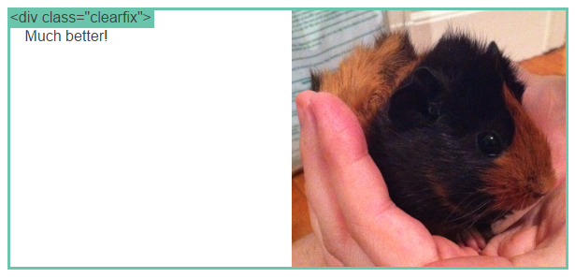
Clearfix Hack
We can get around this by using “the clearfix hack.”

Slide 39
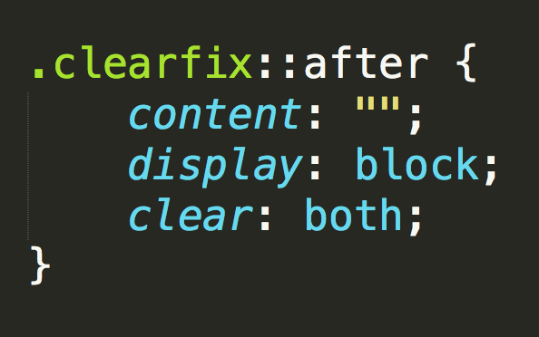
Clearfix Hack
::after is what we call a pseudo-element. We use it to style specific parts of an element.
This will add an HTML element, hidden from view, after the content of the “.clearfix” element. This clears the float.

Slide 40

Quick Demo!

Slide 41
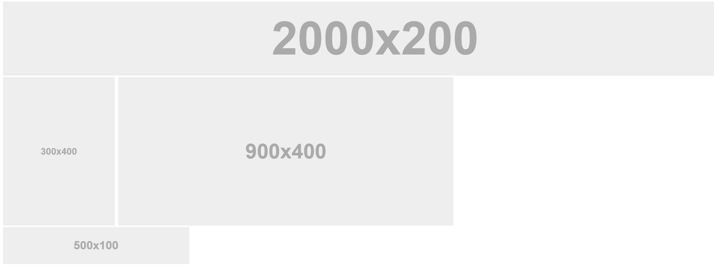
Quick Demo!

Slide 42
Quick Demo
Instructor: Demo
(2-FloatExamples)

Slide 43

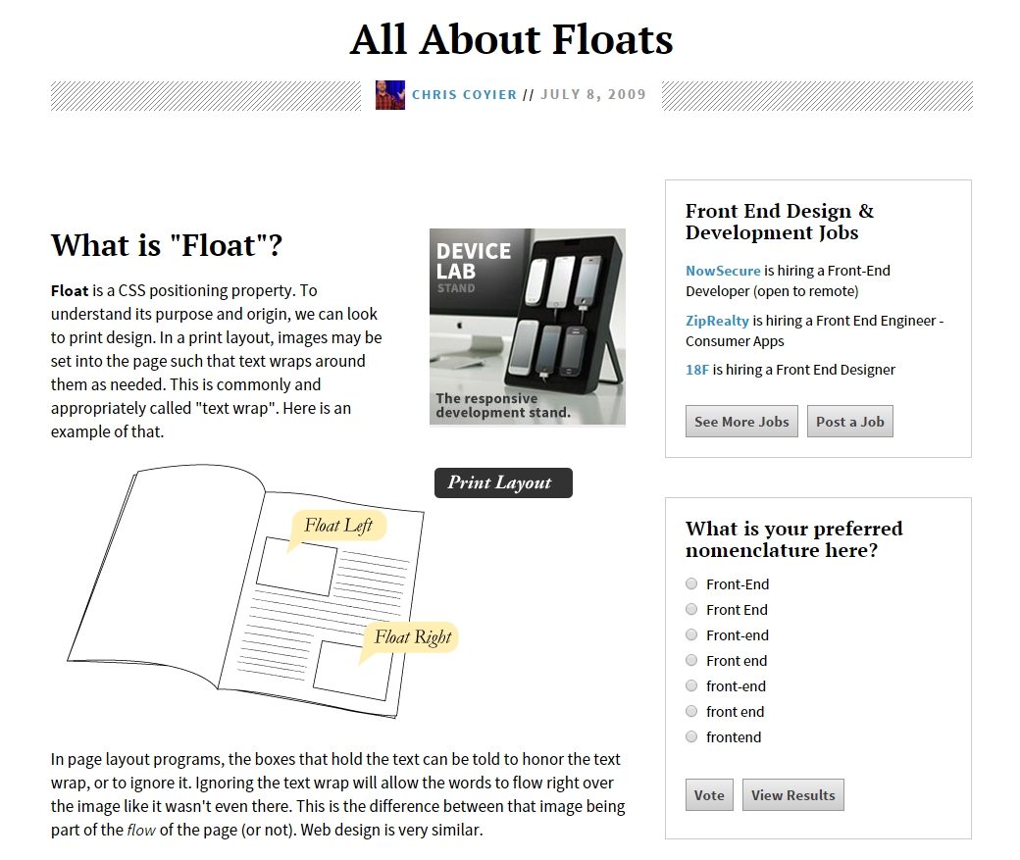
Fantastic Guide on Floats ****
To all serious front-end developers (this is a necessary read): https://css-tricks.com/all-about-floats/

Slide 44
> YOUR TURN!!
Activity: 3-FloatLayout-Activity | Suggested Time: 30 min
Assignment
In this activity, you’ll flex your newfound floating skills by creating a conceptual layout. Eyeball the design to your best ability.
Check your Slack for more instructions.

Slide 45
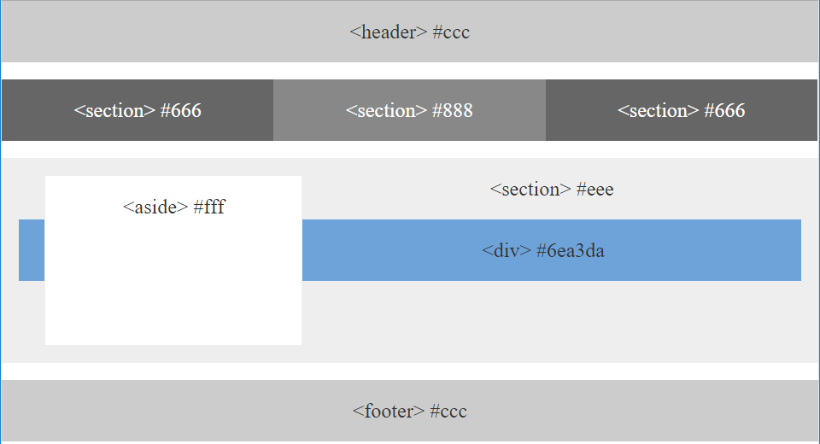
> YOUR TURN!!

Slide 46

Good work!
Your brain may rest now…

Slide 47
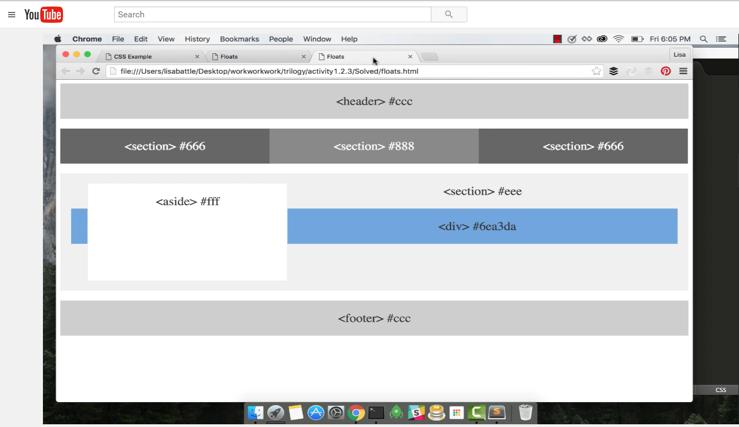
Video Walkthrough! (Highly, HIGHLY Recommend!!!)
Video Link: https://youtu.be/0lpxKw6E90Y

Slide 48
BREAK!

Slide 49
CSS Positioning

Slide 50
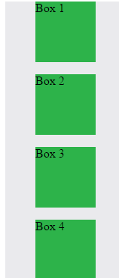
Position: Static (Default)
Four boxes placed statically (default)

Slide 51
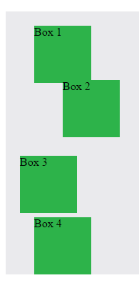

Position: Relative
Switching the boxes to relative will nudge the boxes in relation to their “original” location.

Slide 52
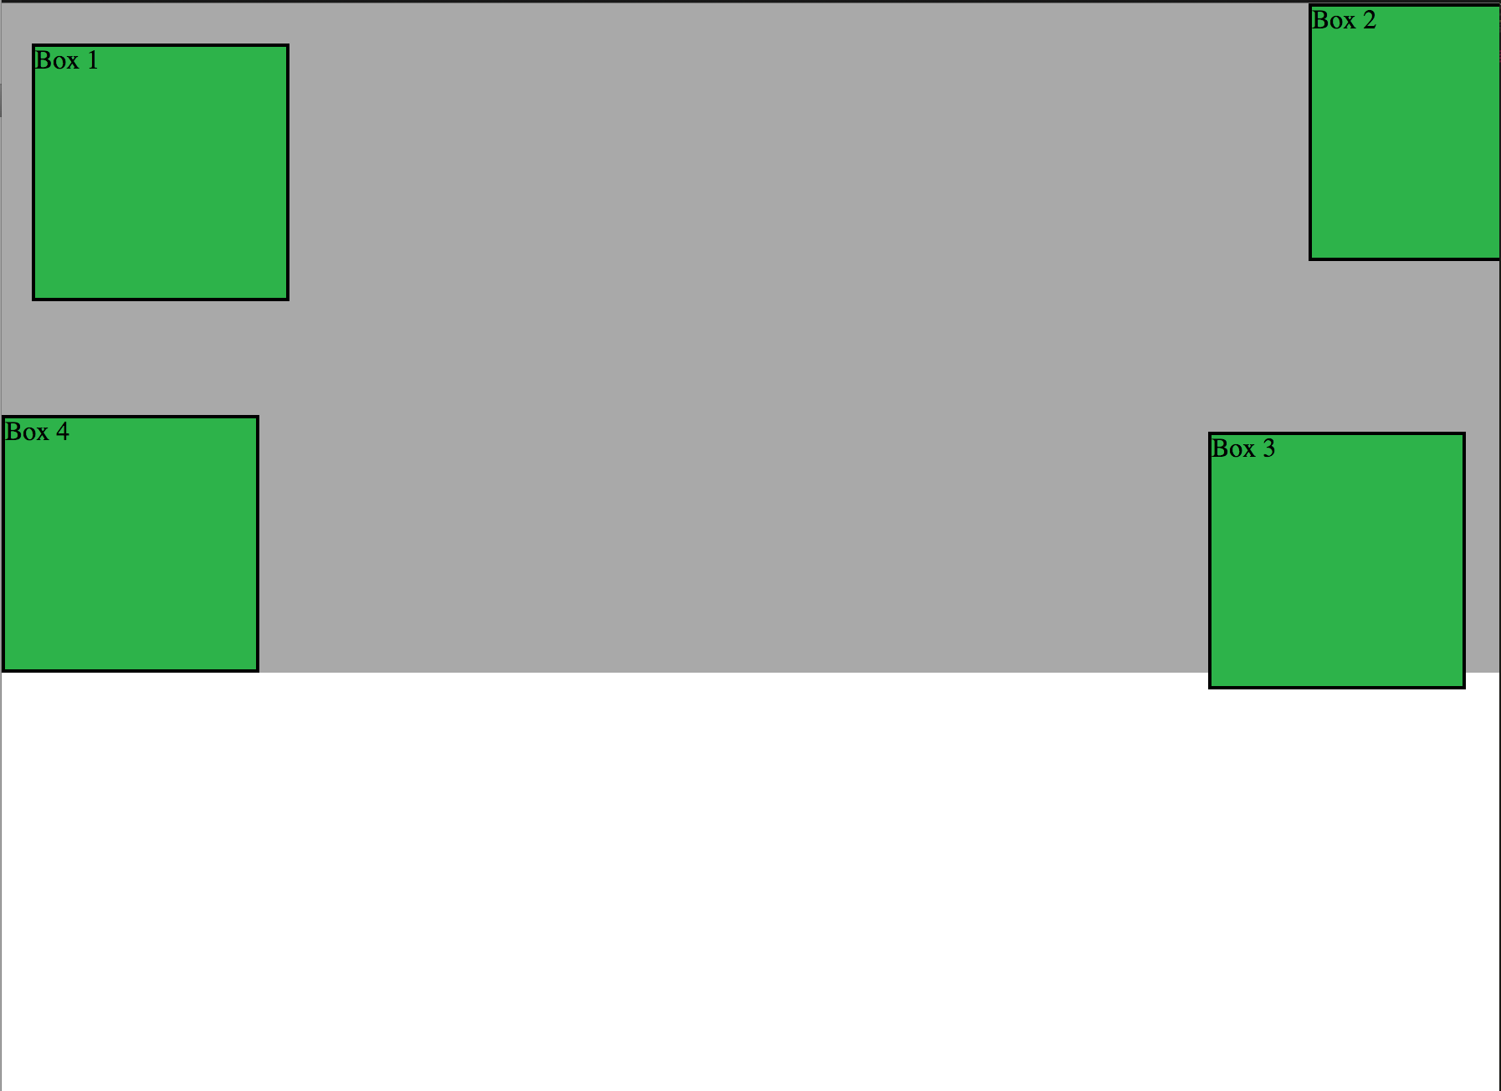
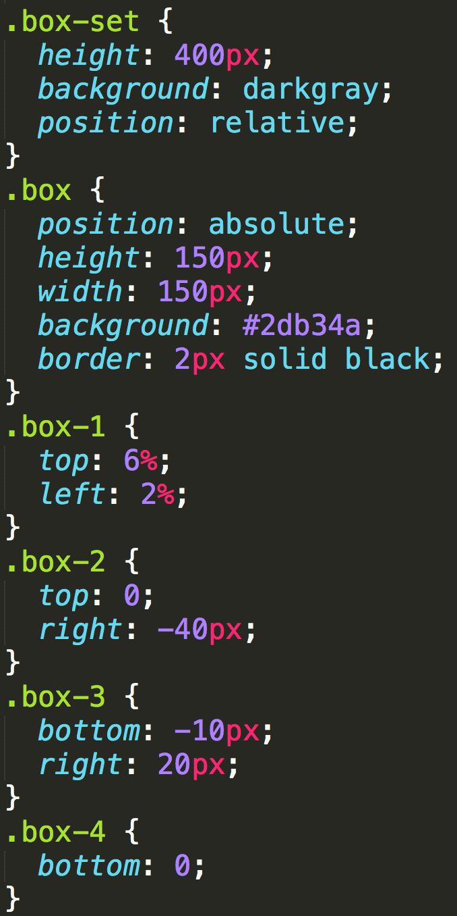
Position: Absolute
Positioned relative to nearest positioned ancestor
Notes:
An element that is positioned absolutely is taken out of the flow and thus takes up no space when placing other elements.
The absolutely positioned element is positioned relative to nearest positioned ancestor (non-static).
If a positioned ancestor doesn't exist, the initial container (body) is used.

Slide 53
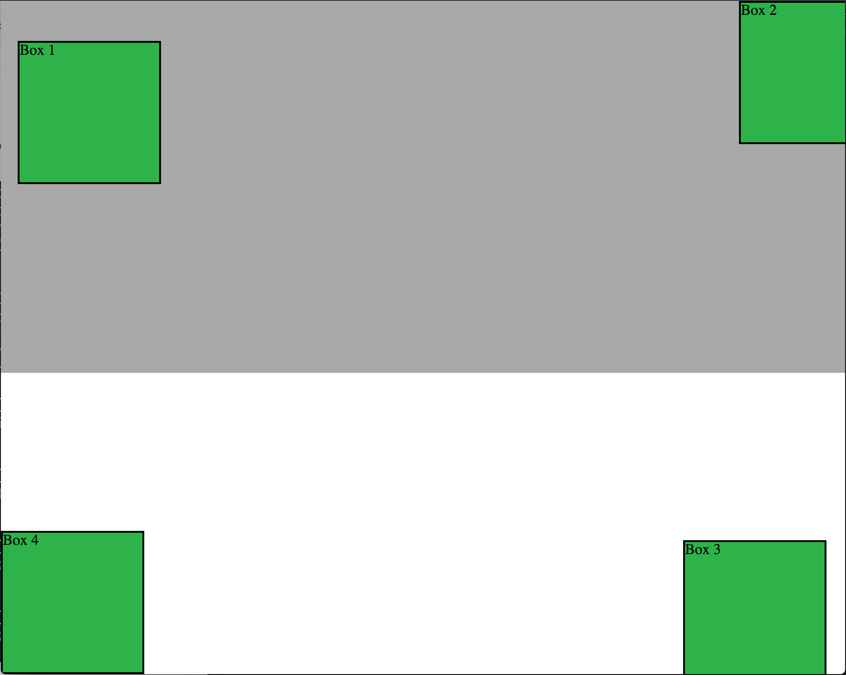
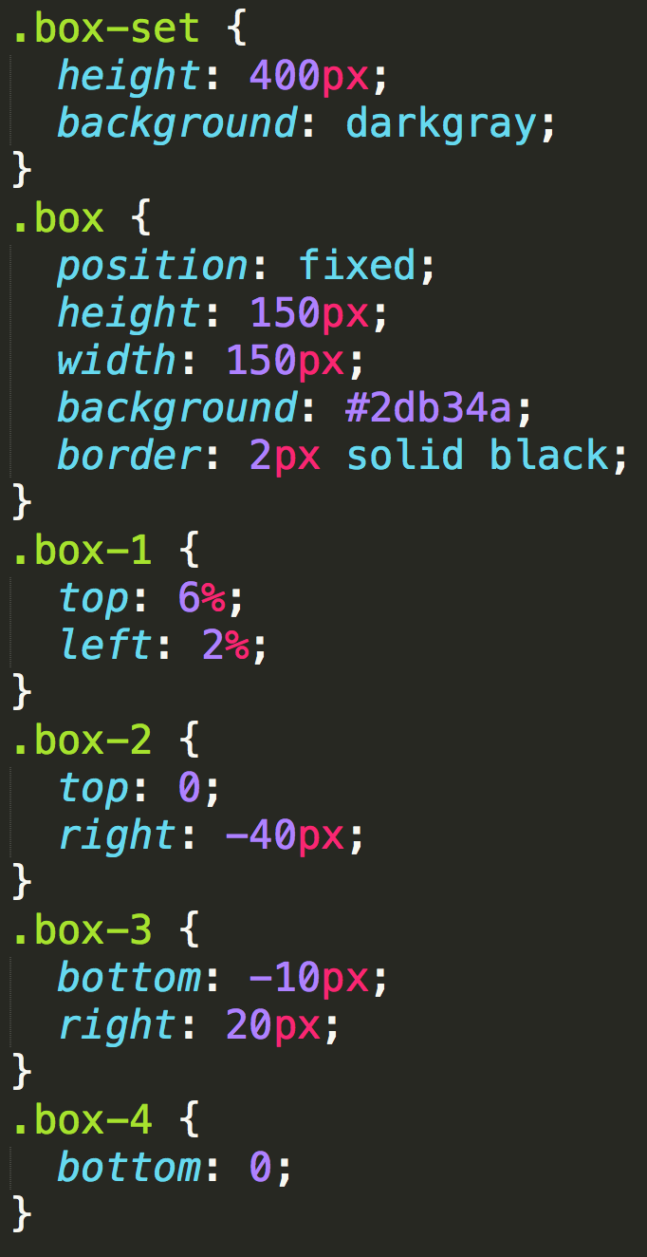
Position: Fixed
Position with exact coordinates to the browser window

Slide 54
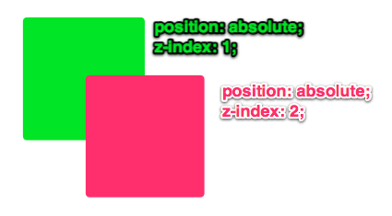
Layering with Z-Index
Z-Index allows you to layer elements on top of each other when they’re positioned.
Notes:
The elements must be positioned (any position other than static)

Slide 55
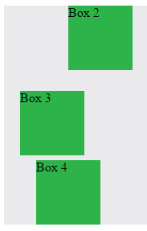
Hiding Things
“Display: none” allows us to hide elements from view.
This will become useful in later sections, when we’ll be hiding and revealing specific HTML elements of our choice.

Slide 56
Quick Demo

Slide 57
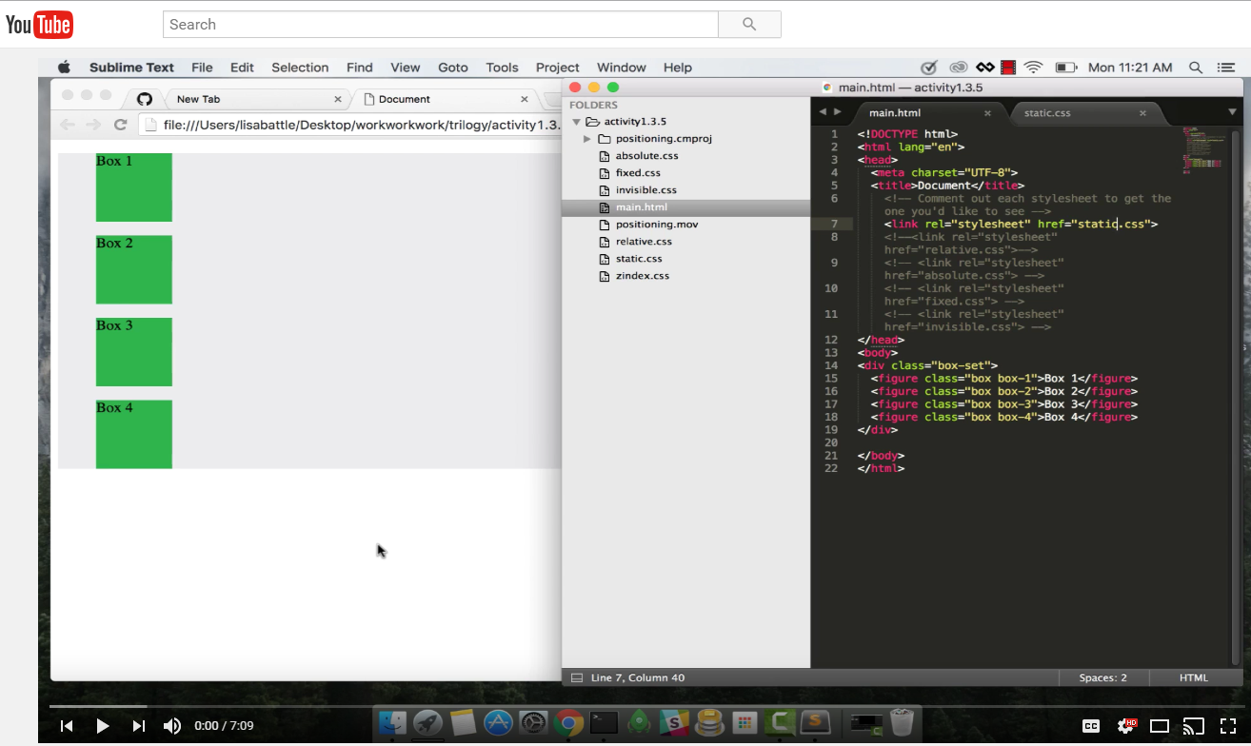
Video Walkthrough!
Video Link: https://youtu.be/sHfJn0jqBro

Slide 58
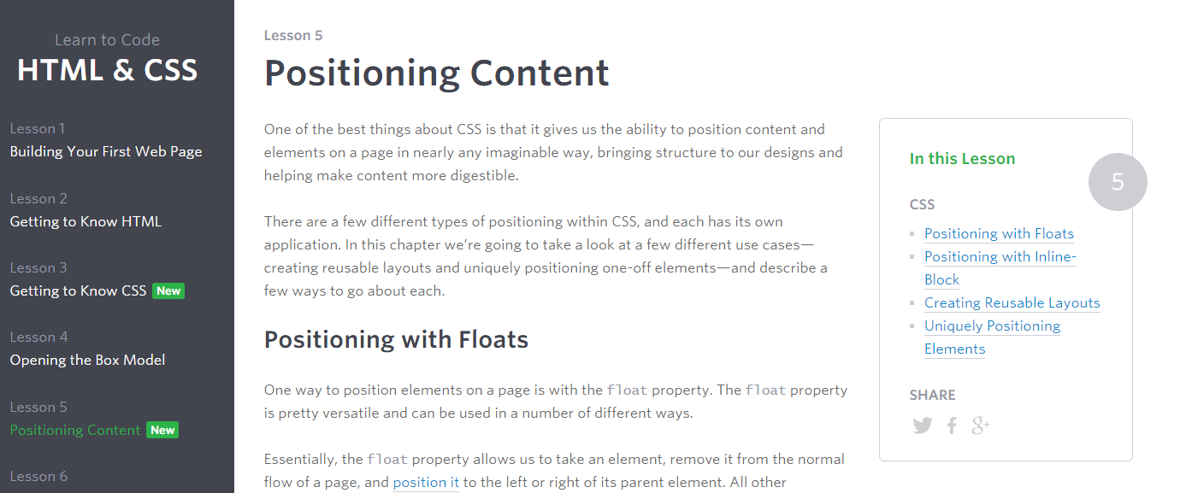
Great Resource
Another great read for front-end developers: http://learn.shayhowe.com/html-css/positioning-content/

Slide 59
> YOUR TURN!!
6-CSS_Positioned_Activity | Suggested Time: 30 min
Assignment
In this activity, you’ll flex your newfound positioning skills by creating another conceptual layout. Eyeball the design to your best ability.
Check your Slack for additional instructions.

Slide 60

> YOUR TURN!!

Slide 61
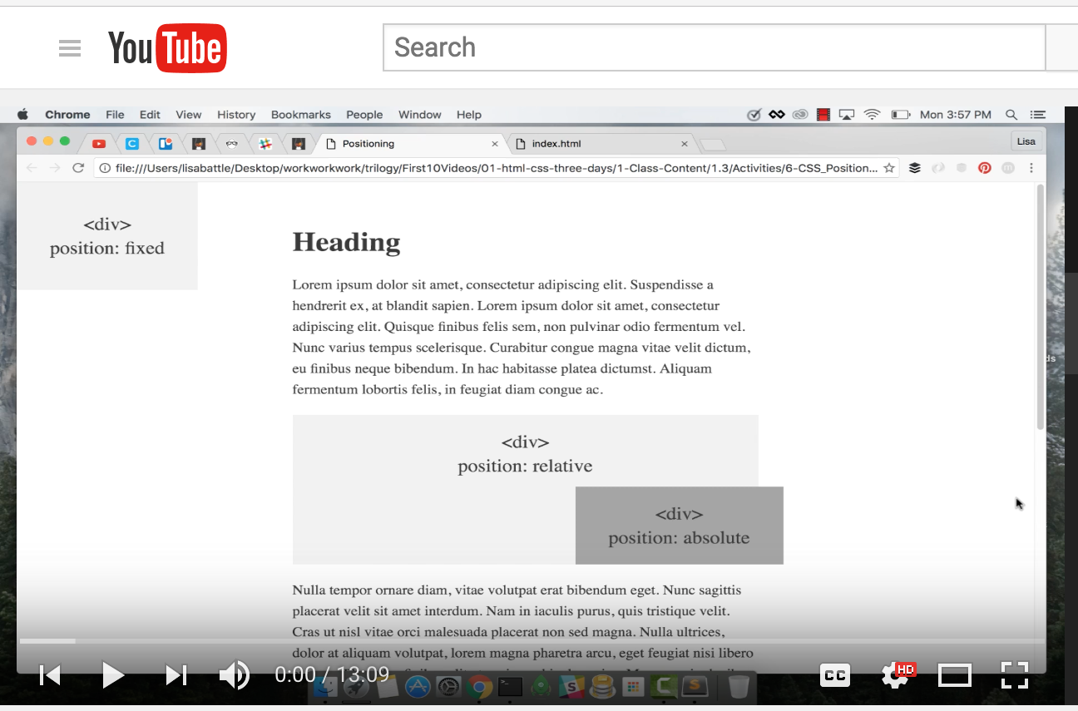
Video Walkthrough!
Video Link: https://youtu.be/yWXgnQaWSW0

Slide 62
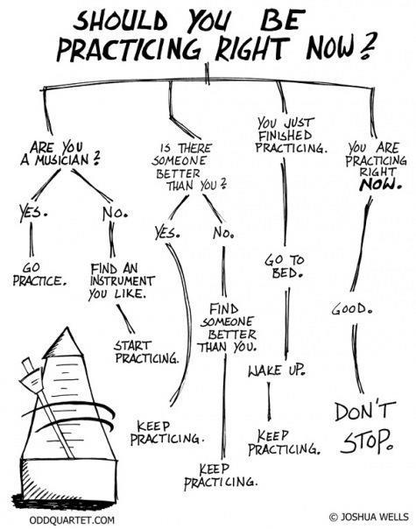
Advice
Re-do this at home. We designed this exercise
to firm up your HTML/CSS skills.
REMEMBER:
The best way to learn
web development
is to PRACTICE!

Slide 63
Chrome Inspector

Slide 64
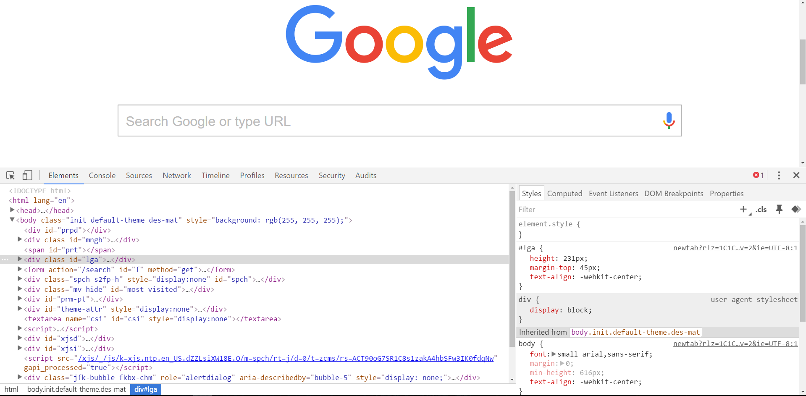
Chrome Inspector is Your Friend
To access chrome inspector, right click on a page. Then hit “Inspect.”
It will allow you to inspect the HTML, CSS and more!

Slide 65

Chrome Inspector is Your Friend
You can even edit the HTML/CSS of a webpage and instantly view your changes in the browser!
This works on any website, whether yours or not.

Slide 66
Next Class!
We’ll be coming back to this
in our next class.

Slide 67
Recap + Reassurances

Slide 68


Slide 69
Questions?

